Slide 1
WDP325 Python Django 網站程式設計 325 期 期末作品
吳自回

Slide 2
動機:
學校課務網頁不支援行動版，老舊的介面、排版，非響應式設計，使用上不夠直觀也不夠友善。以及學生課表無法直接輸出，大多數的學生僅透過截圖方式得到課表。
網頁設計思路:
在Django基礎上，與東吳大學課務系統透過後端HTTP請求方式，成功登入後，取得學生個人資料、課表資訊，後端整理後，再將以上資訊顯示在前端上。

Slide 3
架構:
Model:
Session
id
passwrd
name
schclass
Template:
index.html (主頁面)
login.html (登入畫面)
loginFailed.html (登入錯誤頁面)
schedule.html (課表功能頁面)
View:
responseHome(request): 回傳主頁
responseLogin(request): 回傳登入頁面
responseSchedule(request): 回傳課表功能頁面
stream_response(request): 從前端POST資料/做Session儲存/登入驗證
getTable(id, passwd): 設置並儲存HTTP請求目標網站之Cookies/取得課表資料html raw data/透過Beautiful Soup整理
tableSort(trs): 課表資料透過Pandas處理
drawTable1(df): 模板一繪製(透過ImageDraw Module — Pillow)
drawTable2(df): 模板二繪製(透過ImageDraw Module — Pillow)
get_allsessions(request): 取出所有sessions檢查
delete_session(request,key=None): 刪除指定session

Slide 4
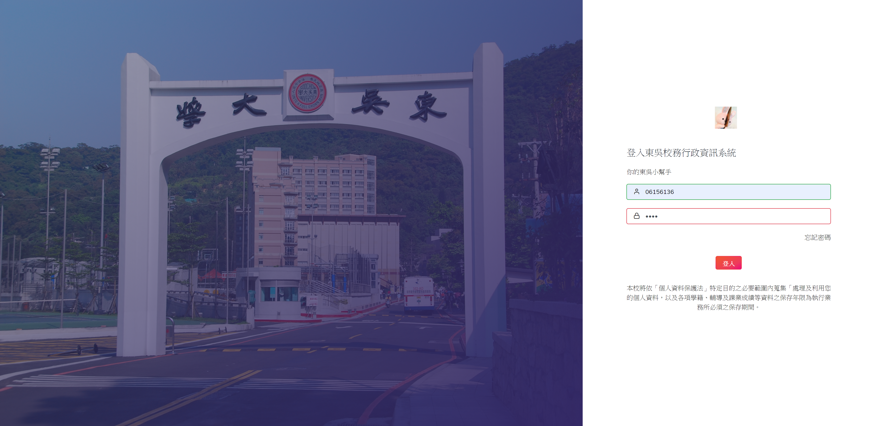
使用者透過前端輸入學號密碼登入 > 對校務系統發出HTTP Request (w/id&password)

Slide 5
# login
@csrf_exempt
def stream_response(request):
if request.method == 'POST':
if request.POST.get('id', False):
# Session
id = request.POST.get('id')
passwd = request.POST.get('passwd')
if not id in request.session:
request.session['id'] = id
request.session['passwd'] = passwd
else:
message = request.session['id'] +' 您已經登入過了!'
r = requests.post('https://web.sys.scu.edu.tw/login0.asp', data={'id':request.session['id'],'passwd':request.session['passwd']})
if 'Login=ok' in r.headers['Set-Cookie'] and len(id) == 8:
ary = get_info(r)
name = ary[3]
schclass = ary[5]
request.session['name'] = ary[3]
request.session['class'] = ary[5]
template = get_template('index.html')
html = template.render(locals())
return HttpResponse(html)
else:
template = get_template('loginFail.html')
html = template.render(locals())
return HttpResponse(html)
將從login.html的form中POST來的id, passwd
向東吳課務網頁發出HTTP請求
由response中確認id passwd是否有誤
將id, passwd, 整理好的name, class存入session

Slide 6
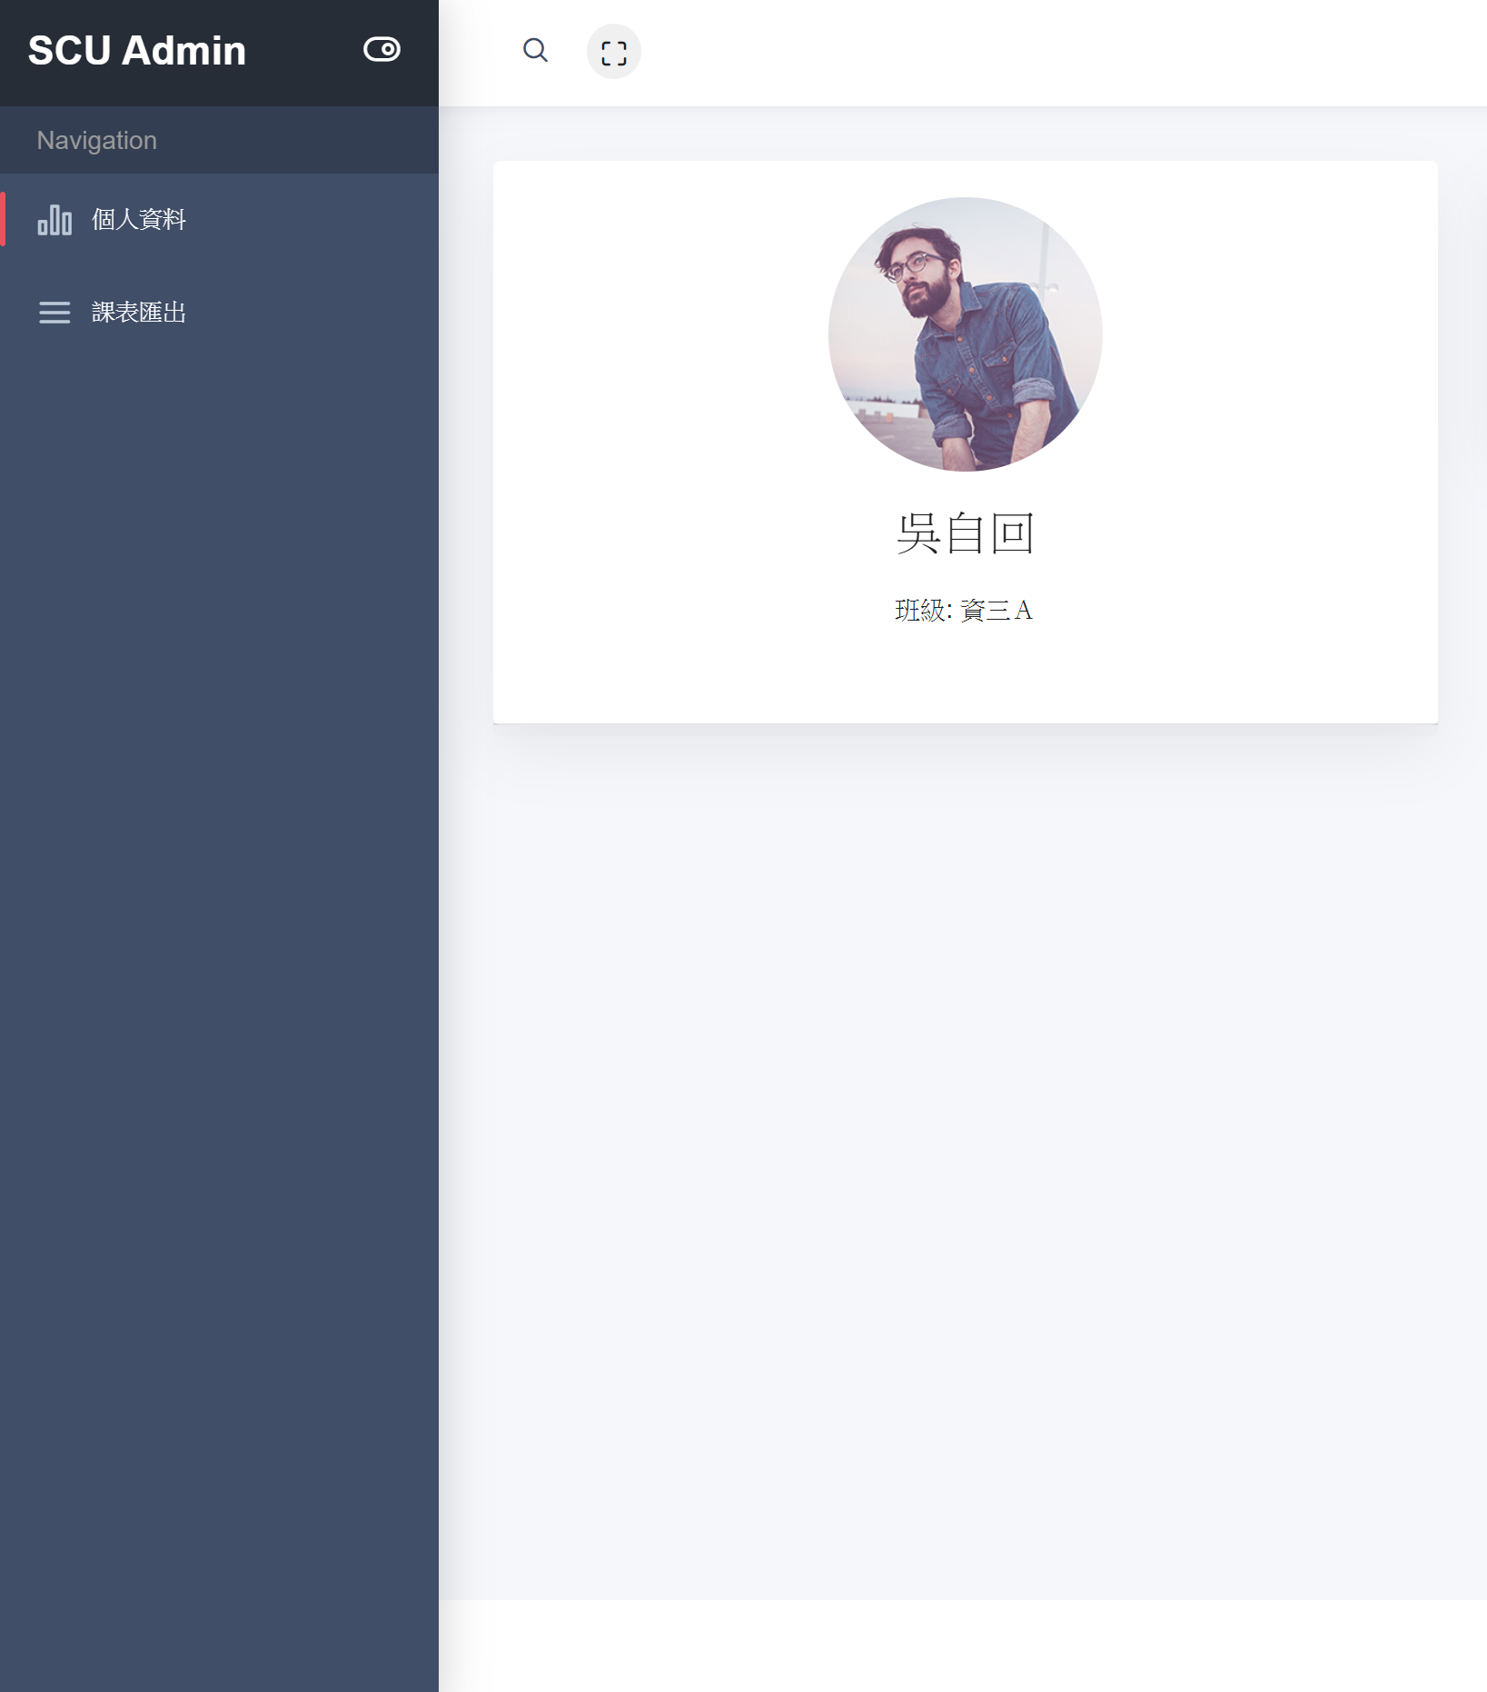
進入主頁面
顯示學姓名、系級

Slide 7
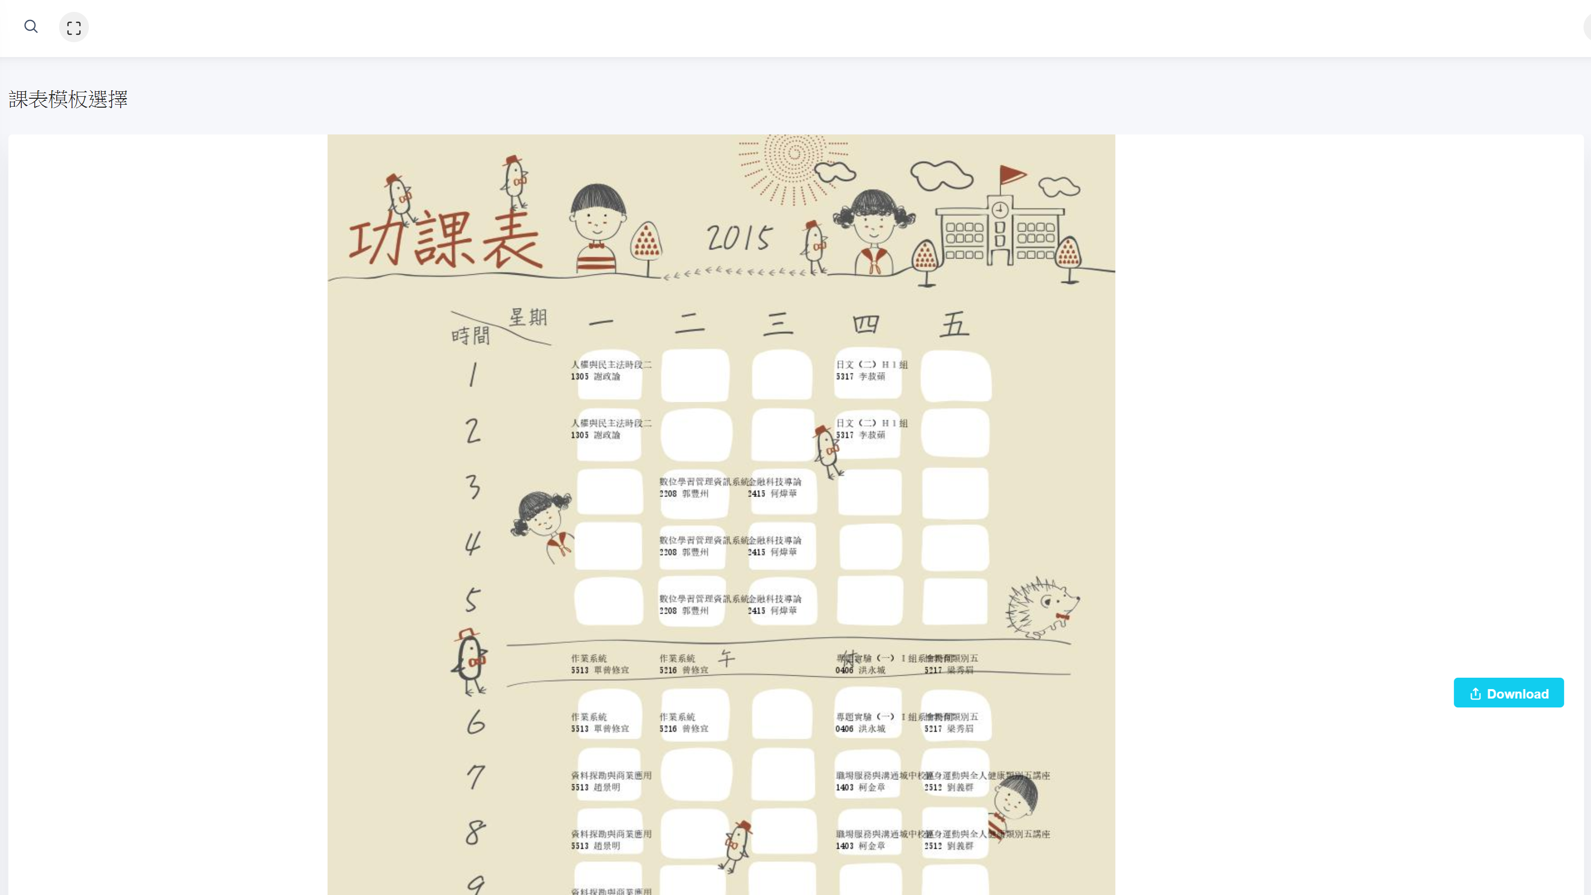
課表匯出功能頁面
可以看到已將課表圖檔整理好
有兩個模板可供挑選
並可以直接點擊下載 而輸出圖檔

Slide 8
def getTable(id, passwd):
r = requests.post('https://web.sys.scu.edu.tw/login0.asp', data={'id':request.session['id'],'passwd':request.session['passwd']})
r.cookies.set('parselimit', 'Infinity')
n = requests.get('https://web.sys.scu.edu.tw/SelectCar/selcar81.asp', cookies = r.cookies, data={'procsyear':'108', 'procterm':'2'})
n.encoding = 'big5'
soup = BeautifulSoup(n.text,"html.parser") #將網頁資料以html.parser
trs = soup.find_all('tr')
df = tableSort(trs)
drawTable1(df)
drawTable2(df)
template = get_template('index.html')
html = template.render(locals())
return HttpResponse(html)
透過先前儲存在session裡的id, passwd
對東吳課務網頁POST請求課表網頁
得到後先用BeautifulSoup整理Html格式

Slide 9
def tableSort(trs):
df = pd.DataFrame(index=['1', '2', '3', '4', 'E', '5', '6', '7', '8', '9', 'A', 'B', 'C', 'D'], #處理Rows
columns=['禮拜一', '禮拜二', '禮拜三', '禮拜四', '禮拜五', '禮拜六', '禮拜日']) #處理columns
count = 0
for tr in trs:
tds = tr.find_all('td')
col_count = 0
if count > 5:
trName = str(count - 1)
else:
trName = str(count)
if count == 5: #非輸字節數處理
trName = "E"
elif count == 11:
trName = 'A'
elif count == 12:
trName = 'B'
elif count == 13:
trName = 'C'
elif count == 14:
trName = 'D'
for td in tds:
tdTxt = str(td.text)
tdTxt = tdTxt[1:].replace(" "," ").replace("\n","(")
if col_count == 1:
df.at[trName, '禮拜一'] = tdTxt
elif col_count == 2:
df.at[trName, '禮拜二'] = tdTxt
elif col_count == 3:
df.at[trName, '禮拜三'] = tdTxt
elif col_count == 4:
df.at[trName, '禮拜四'] = tdTxt
elif col_count == 5:
df.at[trName, '禮拜五'] = tdTxt
elif col_count == 6:
df.at[trName, '禮拜六'] = tdTxt
elif col_count == 7:
df.at[trName, '禮拜日'] = tdTxt
col_count = col_count + 1
count = count + 1
return df
課表文字型態整理成pandas的DataFrame
以方便後面Pillow填圖

Slide 10
def drawTable1(df):
image = Image.open("static/img/課表.jpg")
draw = ImageDraw.Draw(image)
font=ImageFont.truetype("simsun.ttc", 10)
d = 0
e = 0
for index, row in df.iterrows():
if index == '5':
e = 1.5
c = 0
for weekday in row:
for i in range(len(str(weekday))):
if weekday[i].isdigit() and weekday[i+1]!='組':
weekday = weekday.replace(weekday[i],'\n'+weekday[i],1)
break
draw.text((270+(98*c), 250+(65*d)+e), weekday, font=font,fill=(0,0,0))
c = c+1
d = d+1
image.save("static/img/test.jpg")
透過整理好的DataFrame
使用Pillow填圖
並儲存課表圖片

Slide 11
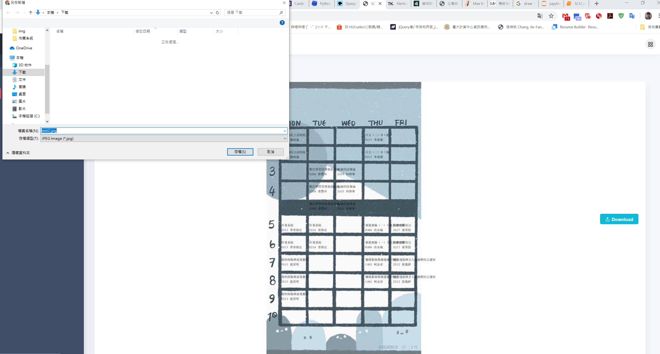
選擇好中意的課表模板後
按下Download按鈕
即可將課表圖片下載到本機

